Slide 1
AI Overview

Slide 2
Contents
How to create account
How to associate your account with the academy
How to join the class and review the material

Slide 3
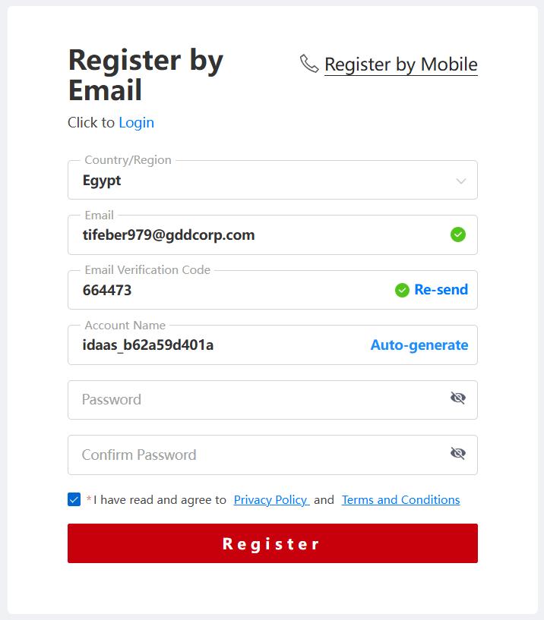
How to create account
open the registration link (Register)
Fill the data in the registration page
Click on Register.
Huawei Proprietary - Restricted Distribution

Slide 4
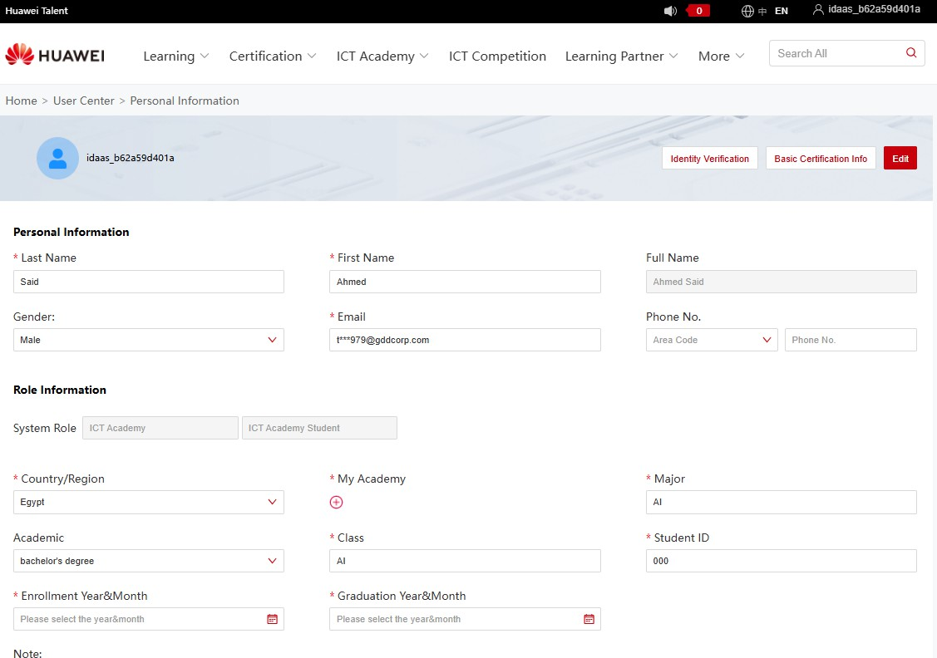
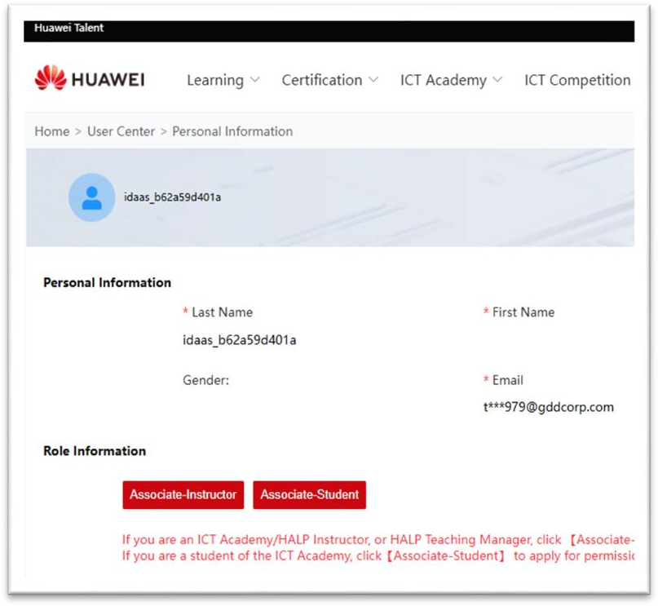
How to associate your account with the academy
1. open My information page (Personal Information)
3. open My information page
2. Click on Associate Student
Huawei Proprietary - Restricted Distribution

Slide 5
3. open My information page (FILL ALL THE REQIRED DATA AS BELOW)
Huawei Proprietary - Restricted Distribution

Slide 6
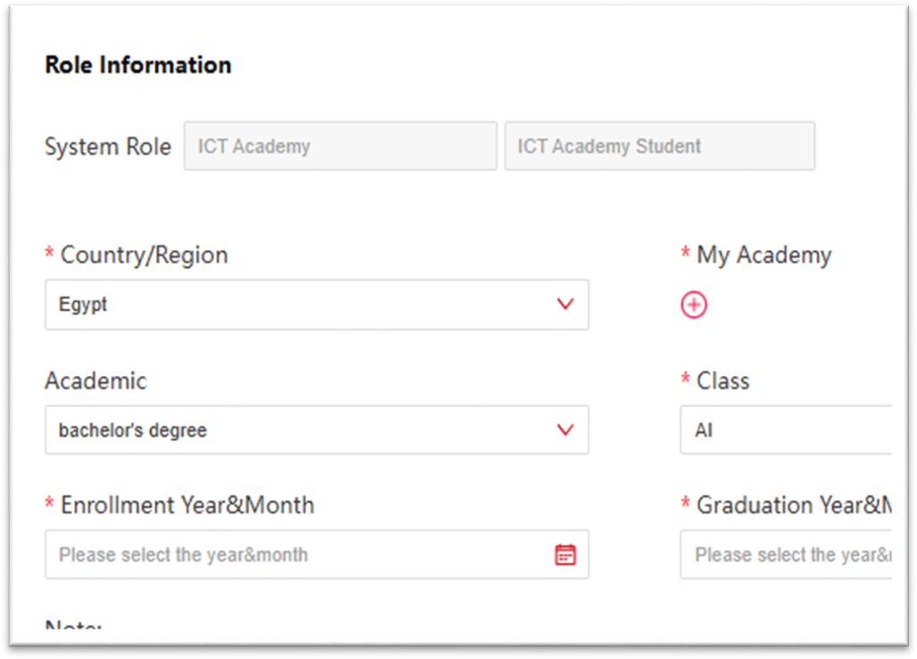
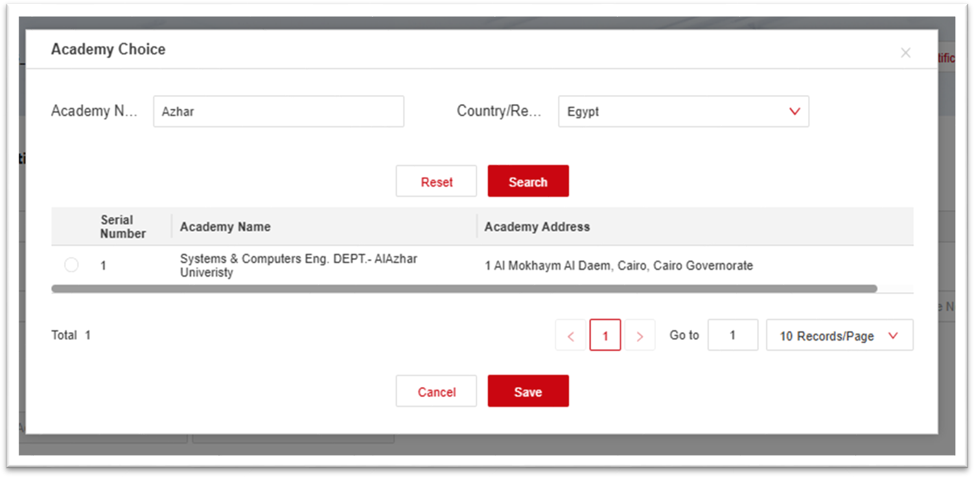
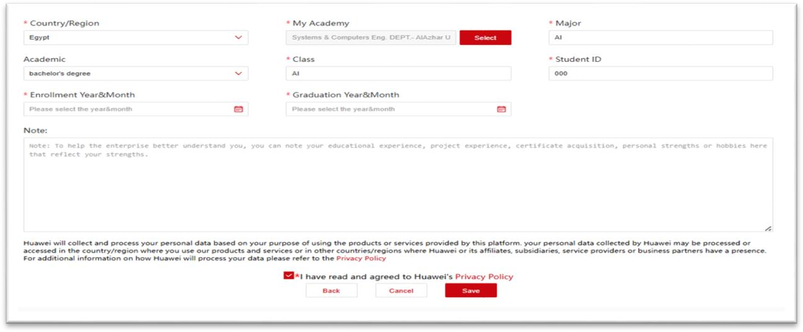
4. Click on the red +
5. Search with your academy name
Write the university name
Click on search
(3)Mark the check box
(4) Click Save
6. Click Save
Huawei Proprietary - Restricted D
istribution

Slide 7

Thank you.
Bring digital to every person, home and organization for a fully connected, intelligent world.
Copyright©2018 Huawei Technologies Co., Ltd. All Rights Reserved.
The information in this document may contain predictive statements including, without limitation, statements regarding the future financial and operating results, future product
portfolio, new technology, etc. There are a number of factors that could cause actual results and developments to differ materially from those expressed or implied in the predictive statements.
Therefore, such information is provided for reference purpose only and constitutes neither an offer nor an acceptance. Huawei may change the information at any time without notice.

